Slide 1
2
Chapter
Managing and managers
Chapter 1 & 9
Management by
Stephen P. Robbins
Marry Coulter

Slide 2
Purpose
By the end of this lecture you will be able to explain:
Who are managers?
Where do they work?
Characteristics of an organization
Difference between managerial and non managerial employees
Differences between General and Functional Managers
1-<number>

Slide 3
Purpose
What is Management?
What are the functions of Management?
Different management levels and their roles
Skills needed for each level
What is Strategic Management?
Different types of Corporate Strategies
Challenges faced by Management
1-<number>

Slide 4
Who Are Managers?
Where Do They Work?
Organization
  Two or more people who work together in a structured way to achieve a goal or a set of goals.
Goal
  The purpose that an organization strives to achieve. Goals are fundamental elements of organization
Common Characteristics of Organizations
  Distinct purpose
  People working together
  A deliberate (carefully thought out at advance) systematic structure
1-<number>
Notes:
Managers work in organizations. We define organizations as A deliberate arrangement of people brought together to accomplish some are deliberate arrangements of people to accomplish a specific purpose. Examples include your college or university, the United Way, your neighborhood convenience store, the Dallas Cowboys football team, fraternities and sororities, the Cleveland Clinic and Nokia.

Slide 5
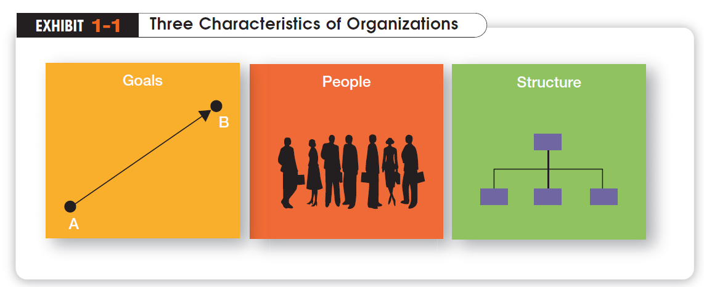
1-<number>

Slide 6
How Are Managers Different from Nonmanagerial Employees?
Nonmanagerial Employees
  People who work directly on a job or task and have no responsibility for overseeing the work of others. Ex: associates, team members, machine operators
Managers
  Individuals in organizations who are responsible for directing the efforts and activities of others aimed at helping organizations achieve their goals.
1-<number>
Notes:
For simplicities sake, we can divide organization members into two categories: nonmanagerial employees and managers. Nonmanagerial employees do not oversee the work of others. Managers direct and oversee the activity of the people in the organization.

Slide 7
What Is Management?
Management
  The process of getting things done effectively and efficiently, with and through people
  The process of planning ,organizing, leading and controlling the work of organization members and of using all available organizational resources to reach stated organizational goals
Effectiveness
  “Doing the right thing”, doing those tasks that help an organization reach its goals
Efficiency
  “Doing things right”. Concerned with the means, efficient use of resources like people, money, and equipment
1-<number>
Notes:
Management is a process of getting things done, effectively and efficiently, with through people. A process is a set of ongoing and interrelated activities. In our definition it refers to the primary activities or functions managers perform.

Slide 8
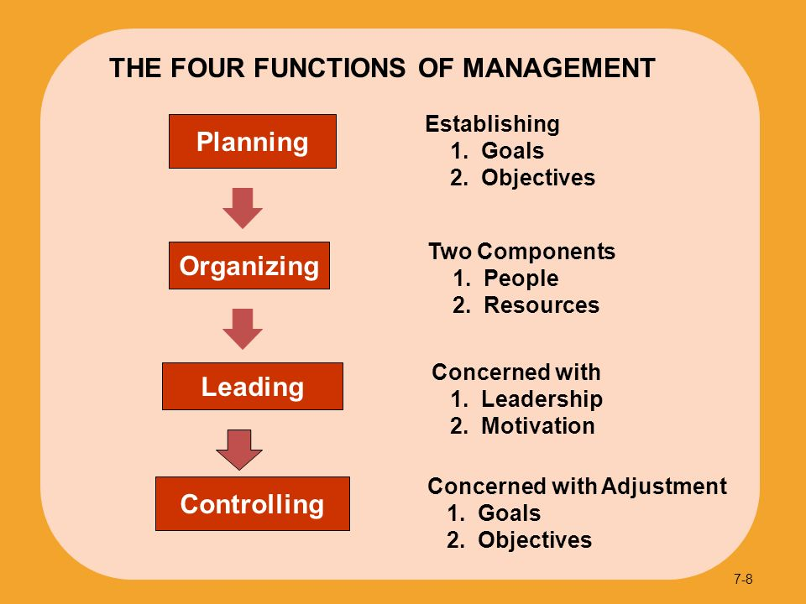
1-<number>

Slide 9
Four Management Functions
Henri Fayol, a French industrialist in the early twentieth century, proposed that all managers perform five management activities: plan, organize, command, coordinate and control. Today these management functions have been condensed to four.
Planning
  Defining the organizational purpose and ways to achieve it
  The process of establishing goals and a suitable course of action for achieving those goals
Organizing
  The process of engaging two or more people in working together in a structured way to achieve a specific goal or a set goals
Leading
  The process of directing and influencing the task-related activities of group members or an entire organization
Controlling :
  The process of ensuring that actual activities conform to planned activities
  Monitoring, comparing, and correcting work performance
1-<number>
Notes:
Planning includes defining goals, establishing strategy, and developing plans to coordinate activities. Organizing includes determining what tasks need to be done and by whom. Leading includes motivating, directing the activities of others, and resolving conflicts. Controlling involves monitoring, comparing, and correcting work performance.

Slide 10
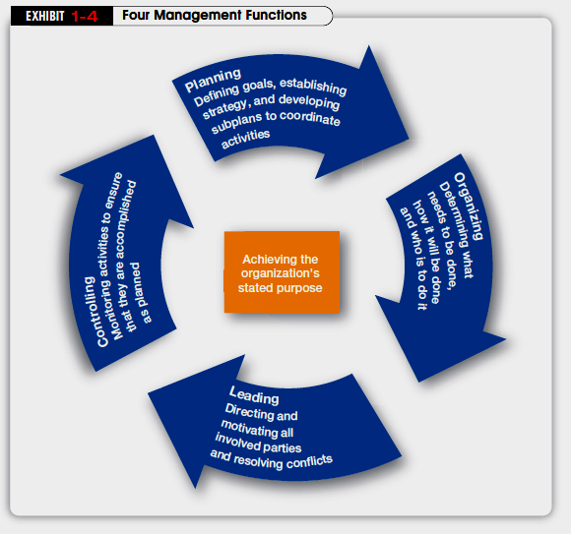
1-<number>

Slide 11
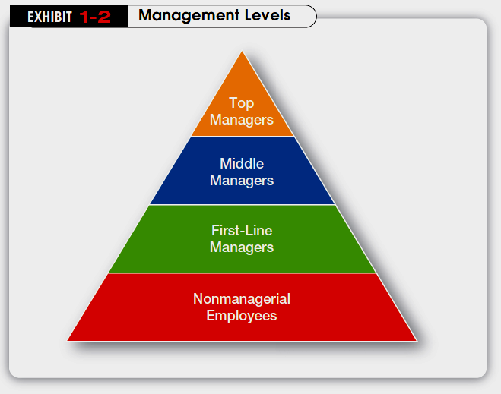
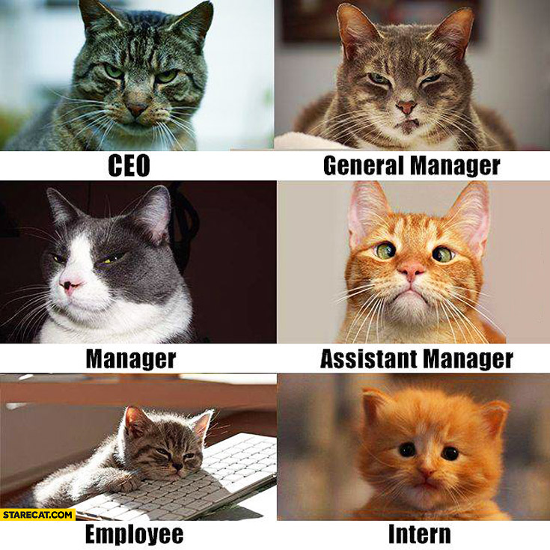
Types of Managers
1-<number>

Slide 12
Management Level
Top Managers
  Responsible for making decisions about the direction of the organization.
  Examples: President, Chief Executive Officer, Vice-President
Middle Managers
  Manage the activities of other managers.
  Examples: District Manager, Division Manager
First-line Managers / Front-line Managers
  Responsible for directing nonmanagerial employees
  Examples: Supervisor, Team Leader
1-<number>
Notes:
Managers are usually classified as top, middle or first-line. But be aware that they can have a variety of titles.

Slide 13
Functional and General Managers
Functional Managers
  The functional manager is responsible for only one functional area or organizational activity, such as: production, marketing or finance
General Managers
  The general manager is responsible for all functional activities for an organization; and oversees a complex unit, such as a company, a subsidiary or an independent operating division. Ex. President, Chief Executive Officer
1-<number>

Slide 14
What Skills Do Managers Need?
Henry Fayol identified three basic kinds of skills
Conceptual Skills
  The ability to coordinate and integrate all of an organization’s interests and activities
Interpersonal/Human Skills
  The ability work with, understand and motivate other people as individuals or in groups. Ex. communicate, motivate, mentor and delegate
Technical Skills
  The ability to use the procedures, techniques, and knowledge of a specialized field. Based on specialized knowledge required for work
1-<number>
Notes:
Another way to describing what managers do is by looking at the skills they need in managing. Managers must possess four critical skills in managing. Conceptual skills, Interpersonal Skills, Technical Skills and Political Skills.

Slide 15
What Skills Do Managers Need?
Relative skills Needed for effective performance at different levels of management
Top Management | Conceptual Skill
Middle Management |  |  | Human Skill
First-line Management |  |  |  |  | Technical Skill
1-<number>

Slide 16
Strategic Management
Strategy : Strategies are the plans for how the organization will do whatever it is in business to do, how it will compete successfully, and how it will attract and satisfy its customers in order to achieve its goals.
Strategic management is what managers do to develop the organization’s strategies.
1-<number>

Slide 17

Types of Corporate Strategies
There are 3 types of Corporate Strategies
Growth (Concentration, Horizontal Integration, Vertical Integration and Diversification)
Stability
Renewal
1-<number>
Notes:
A growth strategy is when an organization expands the number of markets served or products offered, either through its current business(es) or
through new business(es).

Slide 18
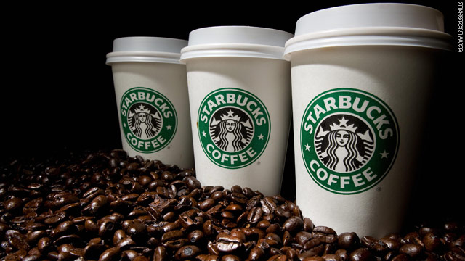
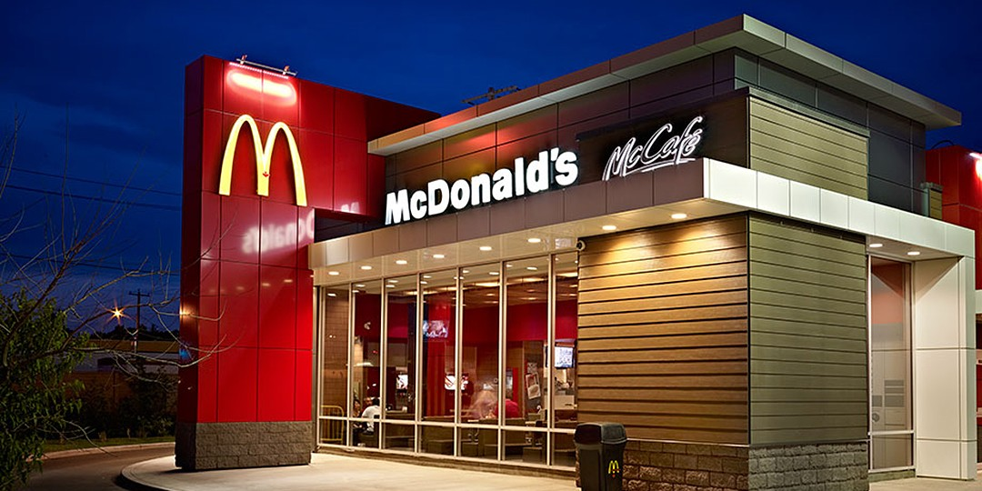
Growth Strategies
Concentration
An organization that grows using concentration focuses on its primary line of business and increases the number of products offered or markets served in this primary business.
1-<number>

Slide 19

Growth Strategies
Vertical Integration (Backward, Forward)
Backward (when you become your supplier)
BATB is its own supplier. It has dedicated farmers cultivating Tobacco.
1-<number>

Slide 20
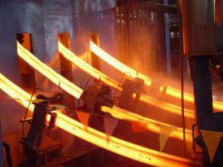
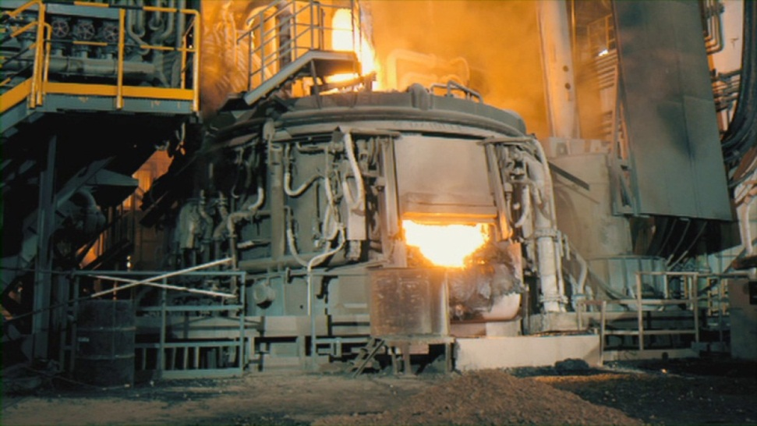
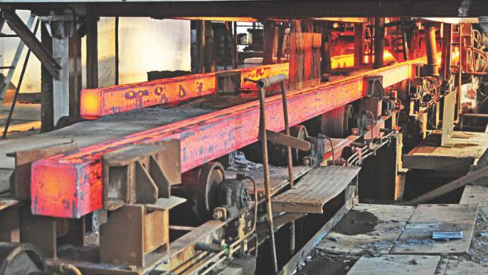

Abul Khair Steel
1-<number>

Slide 21

Growth Strategies
ii. Forward (when you become your retailer)
APPLE has its own retail stores
1-<number>

Slide 22
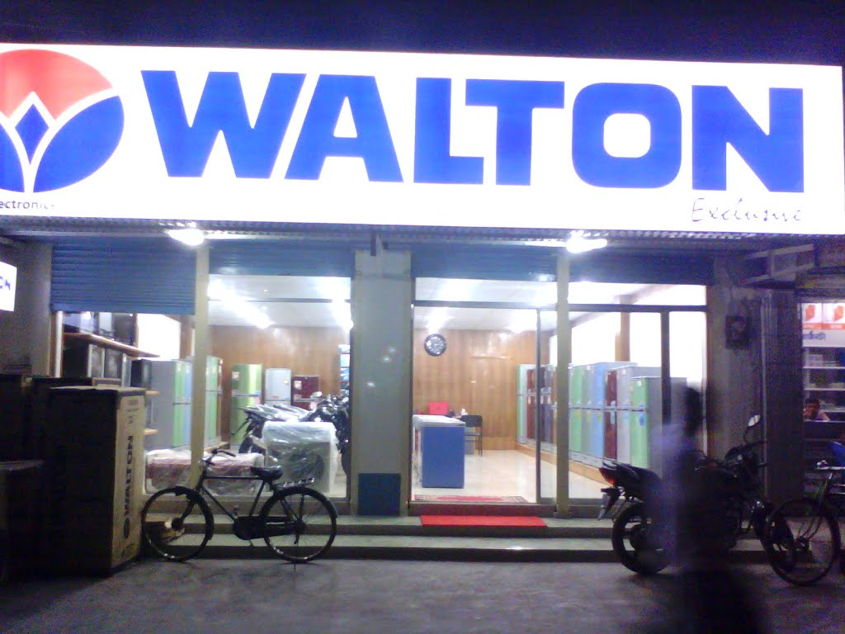


1-<number>

Slide 23
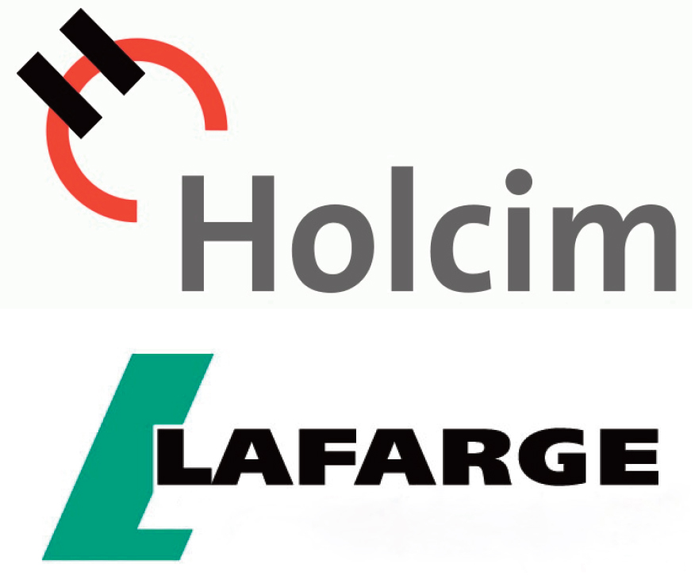

Growth Strategies
Horizontal Integration (when a company grows by combining with competitors)
1-<number>

Slide 24
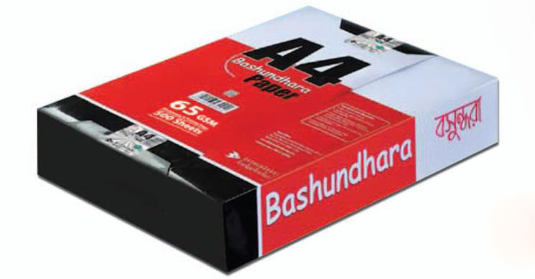


Growth Strategies
Diversification (When a company diversifies its business into many areas)
1-<number>

Slide 25
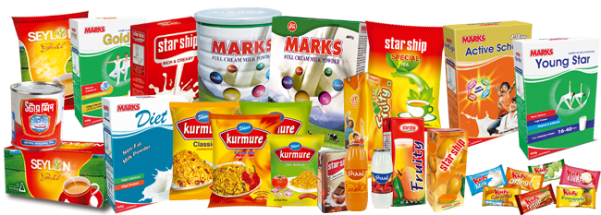
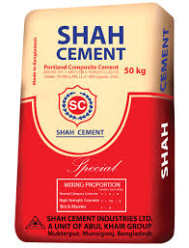
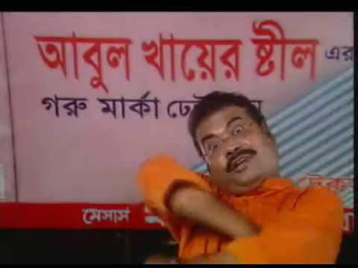
1-<number>

Slide 26
Stability
A stability strategy is a corporate strategy in which an organization continues to do what it is currently doing. Examples of this strategy include continuing to serve the same clients by offering the same product or service, maintaining market share, and sustaining the organization’s current business operations. The organization doesn’t grow, but doesn’t fall behind, either.
1-<number>

Slide 27
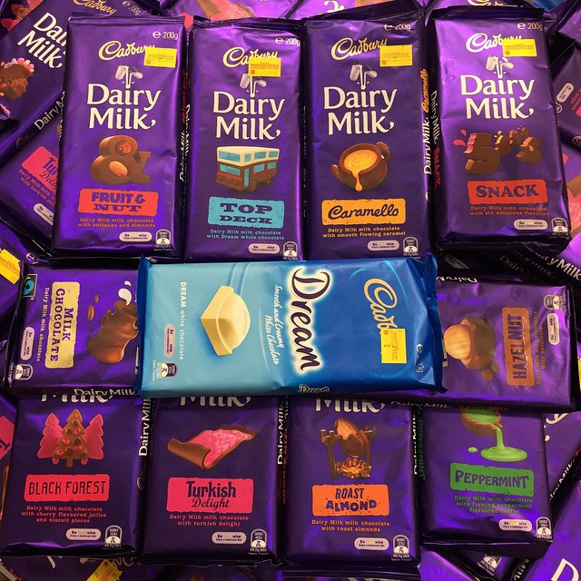
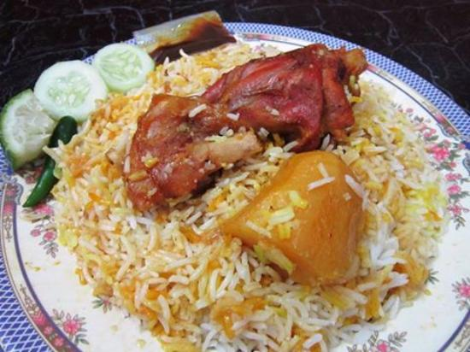

Stability strategy example
As the global recession dragged on and U.S. sales of candy and chocolate
slowed down, Cadbury Schweppes—with almost half of its confectionary sales coming from chocolate—is maintaining things as they are.
1-<number>

Slide 28
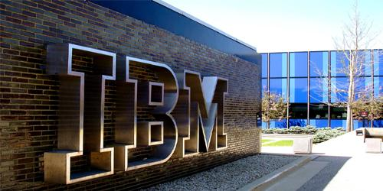
Renewal Strategy
In 1999, IBM concluded that while it was once again a stable business following a near-death experience five years earlier, it had lost its ability to innovate, something dozens of new competitors (including Cisco and Akamai) didn’t hesitate to seize upon. Yet over the past 14 years, IBM has become a new company. It has successfully moved away from hardware and software and refocused itself around consulting, analytics and industry-specific solutions.
cut costs
restructure organizational
operations
1-<number>

Slide 29
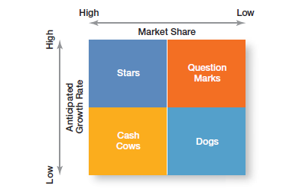
Company Portfolio Management- BCG Matrix
When an organization’s corporate strategy encompasses a number of businesses, managers
can manage this collection, or portfolio, of businesses using a tool called a corporate portfolio matrix. This matrix provides a framework for understanding diverse businesses and helps managers establish priorities for allocating resources.
The first portfolio matrix—the BCG matrix—was developed by the Boston Consulting Group and introduced the idea that an organization’s various businesses could be evaluated and plotted using a 2*2 matrix to identify which ones offered high potential and which were a drain on organizational resources. The horizontal axis represents market share (low or high) and the vertical axis indicates anticipated market growth (low or high).

Slide 30

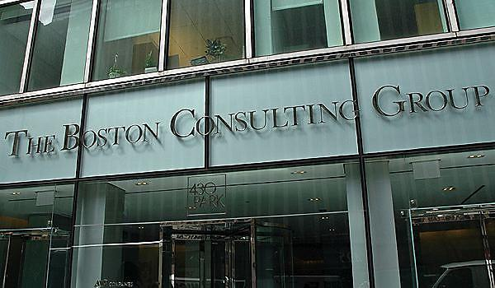
Company Portfolio Management- BCG Matrix
What are the strategic implications of the BCG matrix?
The dogs should be sold off or liquidated as they have low market share in markets with low growth potential.
Managers should take outputs from cash cows for as much as they can, limit any new investment in them, and use the large amounts of cash generated to invest in stars and question marks with strong potential to improve market share.
Heavy investment in stars will help take advantage of the market’s growth and help maintain high market share. The stars, of course, will eventually develop into cash cows as their markets mature and sales growth slows.
The hardest decision for managers relates to the question marks. After careful analysis, some will be sold off and others strategically nurtured into stars.
1-<number>

Slide 31
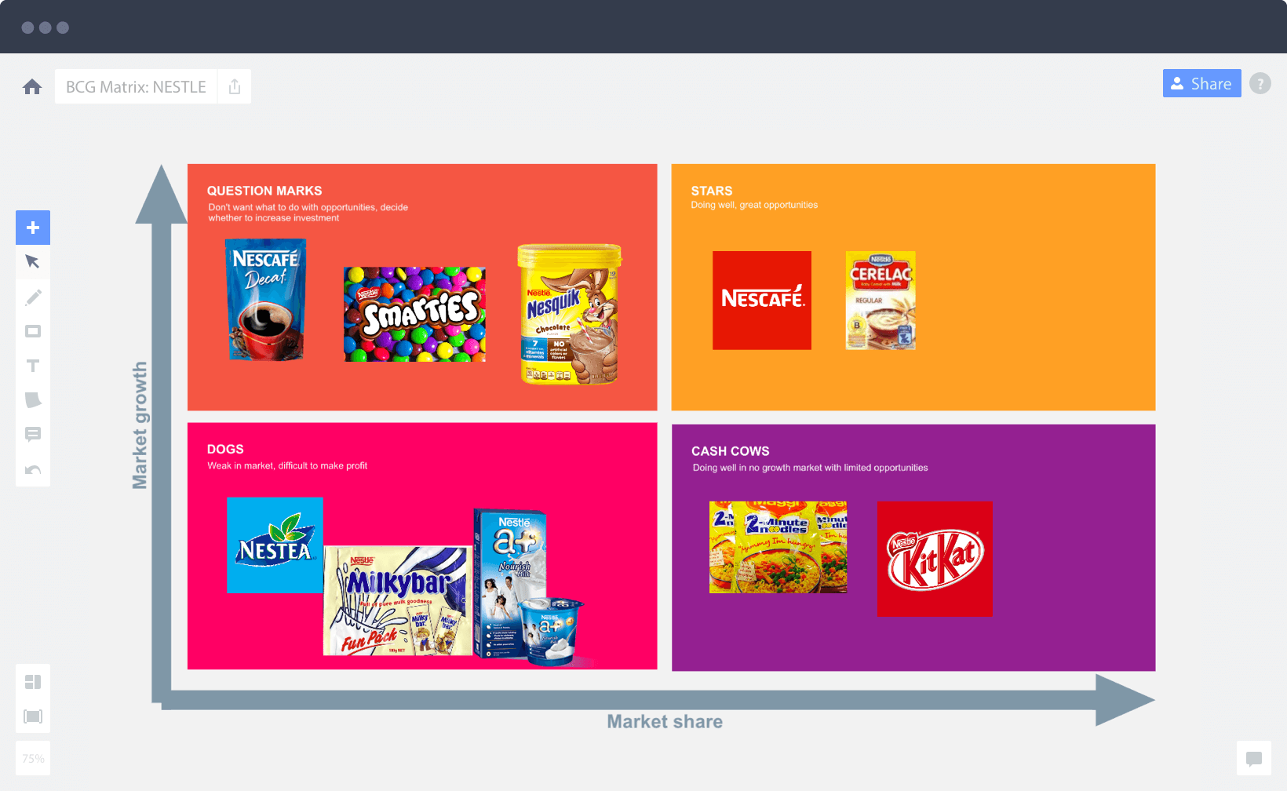
1-<number>

Slide 32
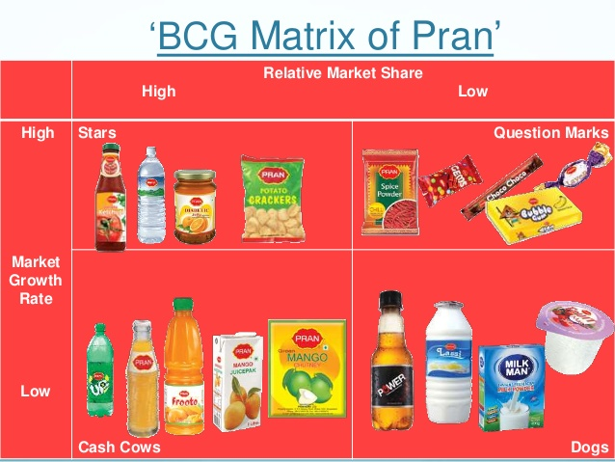
1-<number>

Slide 33

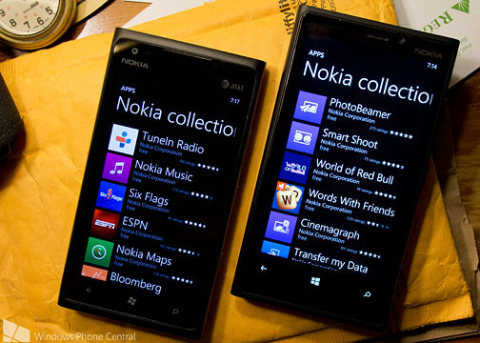
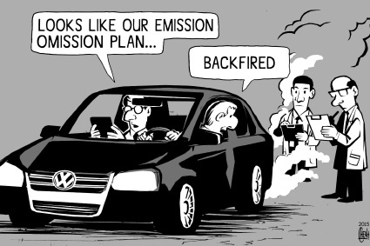

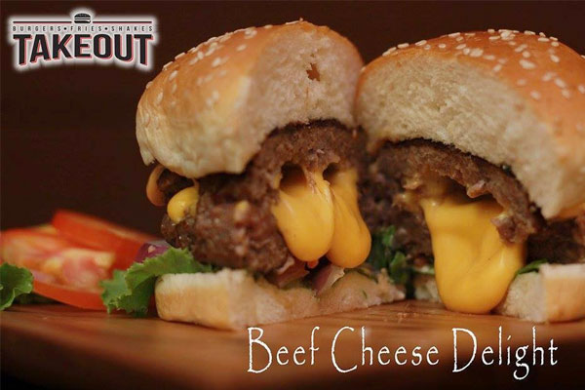
The challenges of Management
The need for Vision
The need for ethics
The need for Responsiveness to cultural Diversity
Bijoy Dripta Barua chowdhury,Lecturer, Dept. of IPE, BUET
1-<number>

Slide 34
The challenges of Management
The need for Vision
  Ex. New Technologies may arrive. Should we accept it or not? (NOKIA – Android case)
The need for Ethics
  Ex. Industrial pollution (Volkswagen car scandal)
The need for Responsiveness to cultural Diversity
  Ex. Have to handle people from different cultures (WALMART faced failure in German market)
1-<number>
Notes:
Managers everywhere are likely to have to manage in changing circumstances and the fact that management is changing.

Slide 35

1-<number>

